Slide 1
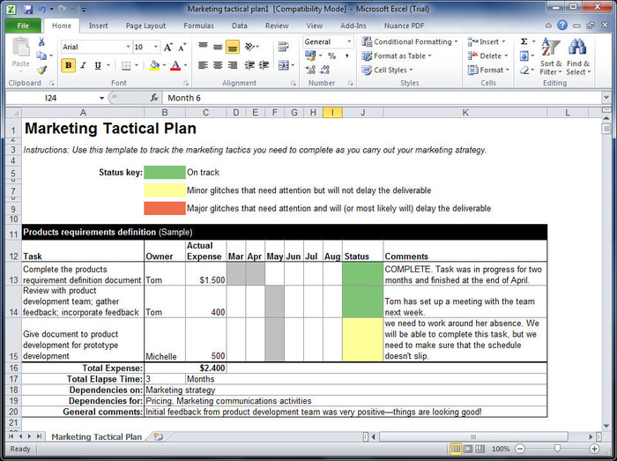
Basics of Excel

Slide 2
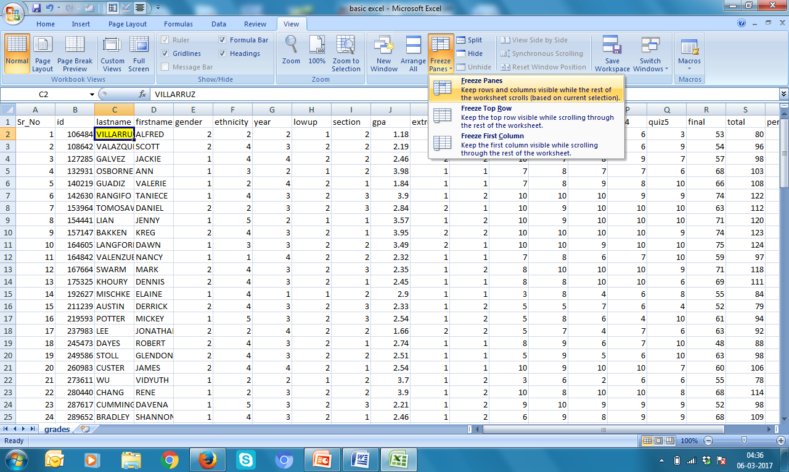
Freezing Panes
1. Keep cursor in the cell from where freezing needed
2. View → Freeze Panes → Freeze Panes
3. For unfreezing panes: View → Freeze Panes → Unfreeze Panes

Slide 3
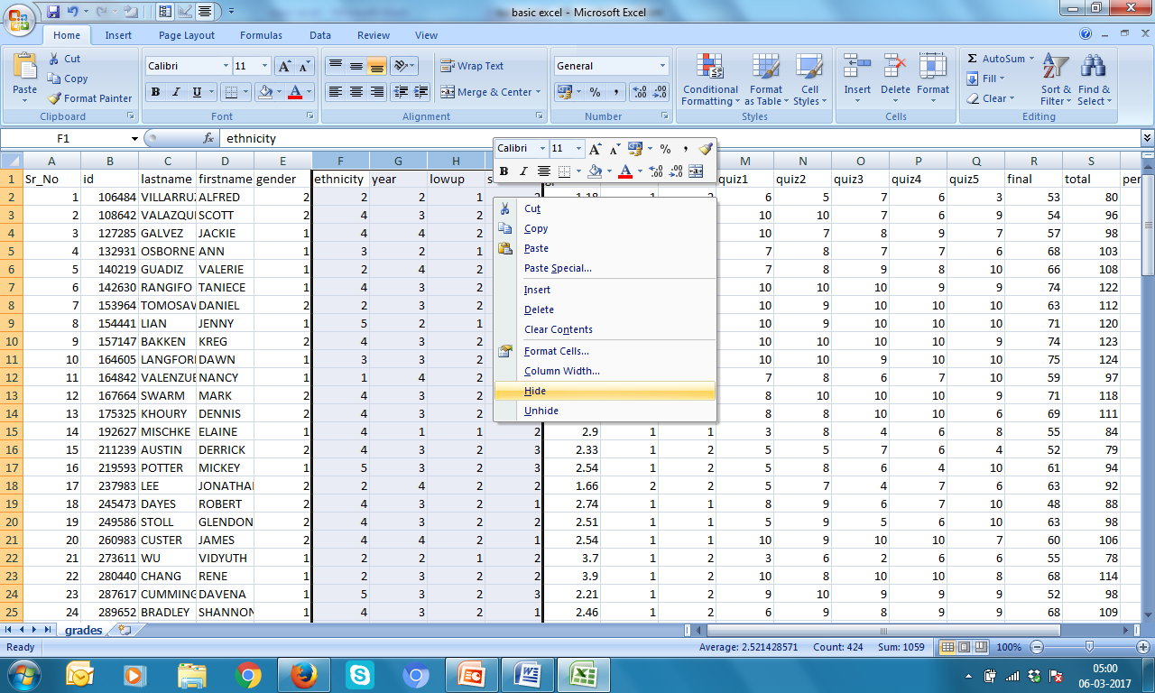
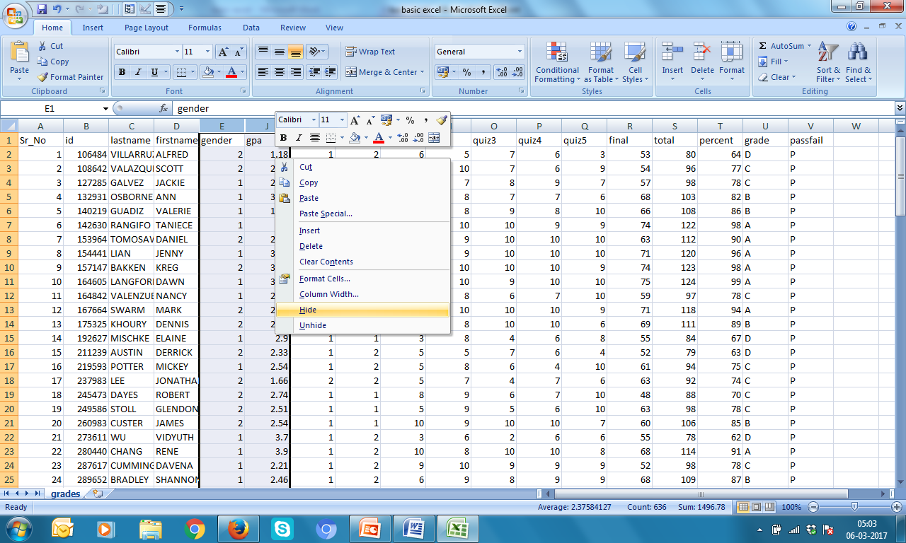
Hiding-Unhiding Rows
1. Hiding: Select rows → Right Click → Hide
2. Unhiding: Select two rows which contains
hidden rows → Right Click →Unhide

Slide 4
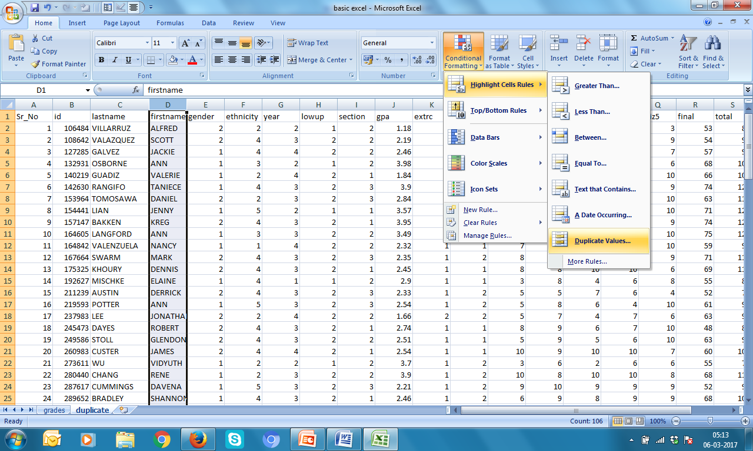
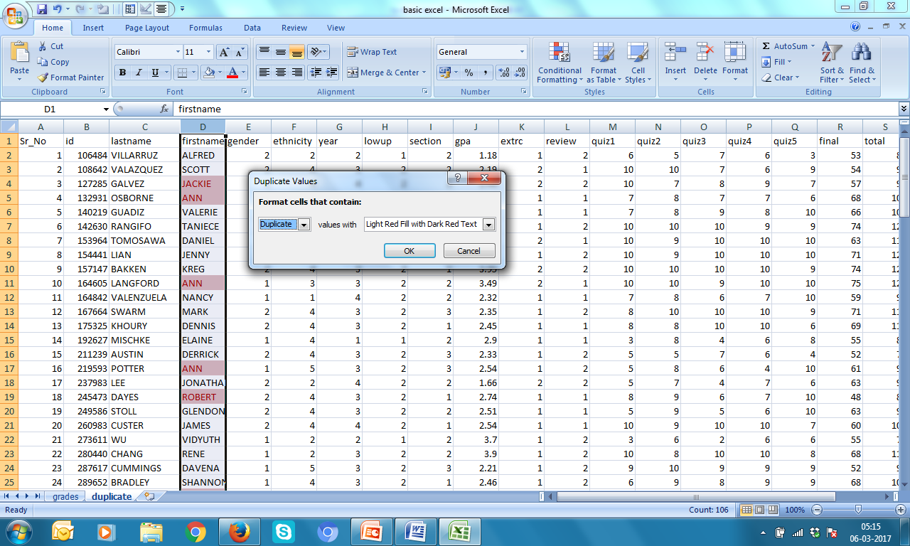
Conditional Formating: Find Duplicates
1. Select row → Conditional Formating → Highlight Rules →
Duplicate Values → select color → OK

Slide 5
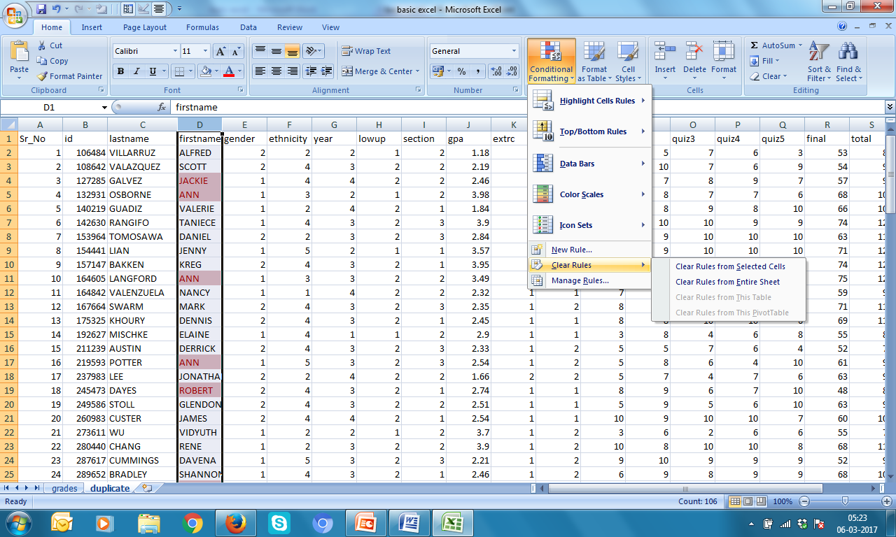
Removing Conditional Formating
1. Select row → Conditional Formating → Highlight Rules →
Clear Rule → Clear Rules from Selected Cells

Slide 6
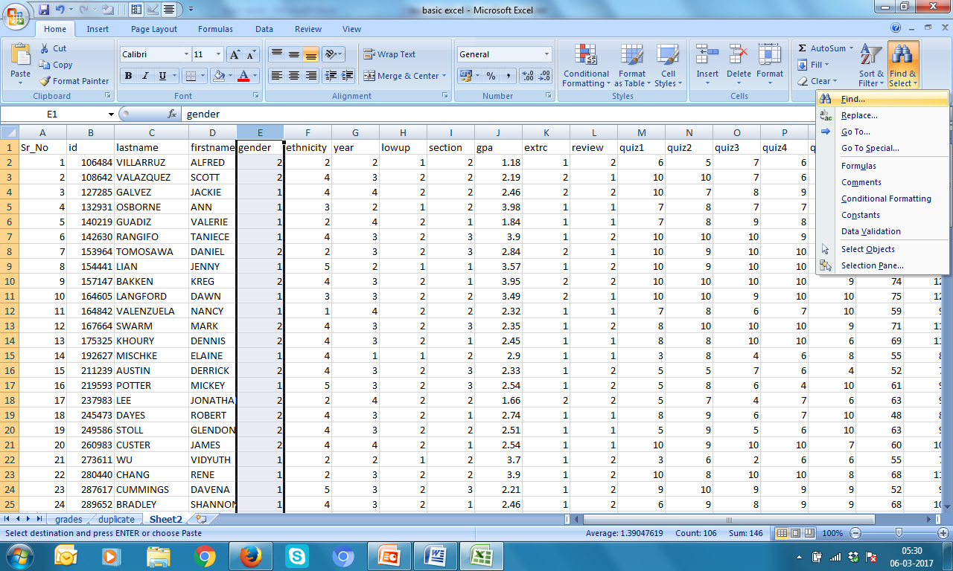
Find & Replace
1. Select Row → Find & Select → Find

Slide 7
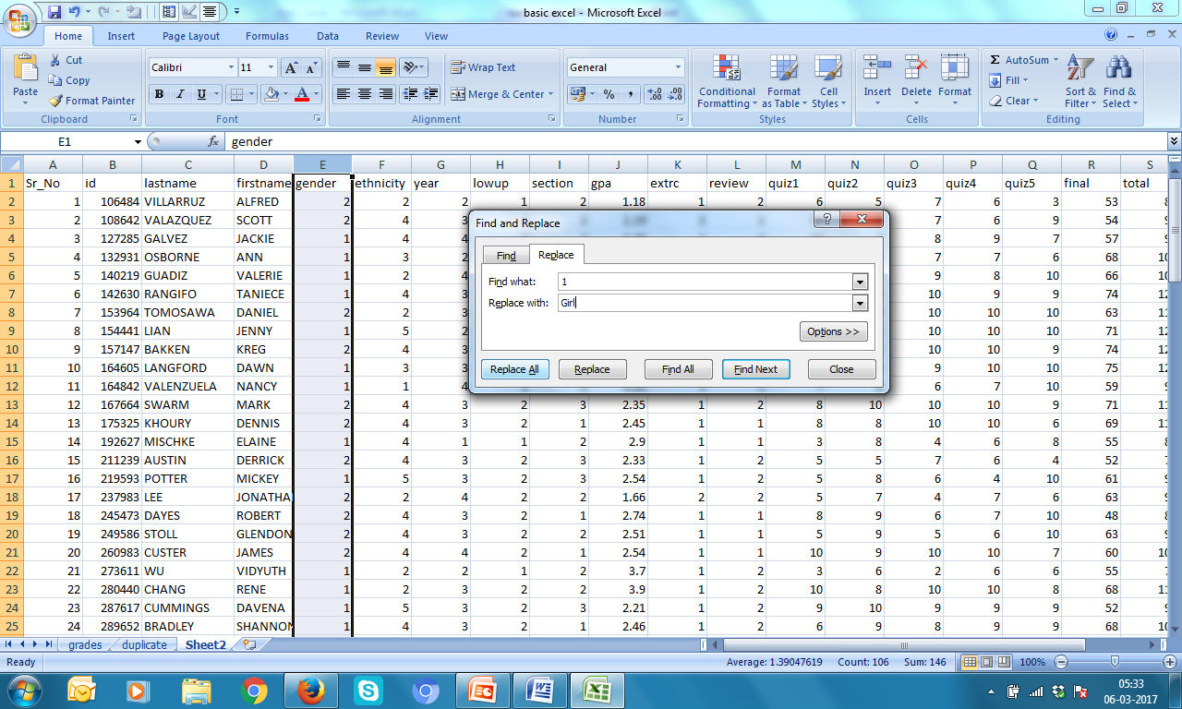
Find & Replace
2. Replace → Type 1 against Find what: &
Girl against Replace with: → Replace All

Slide 8
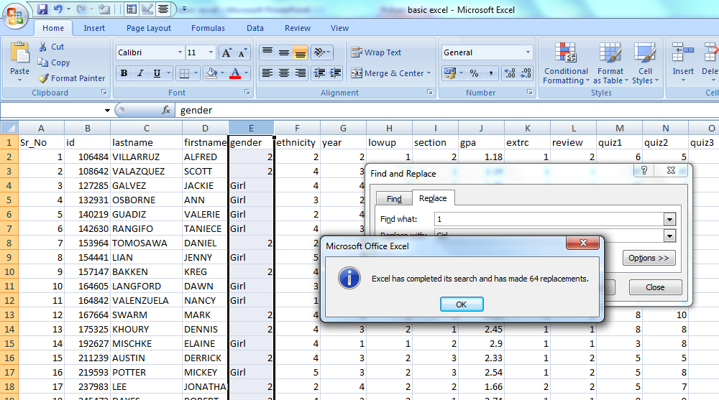
Find & Replace
3. Click OK

Slide 9
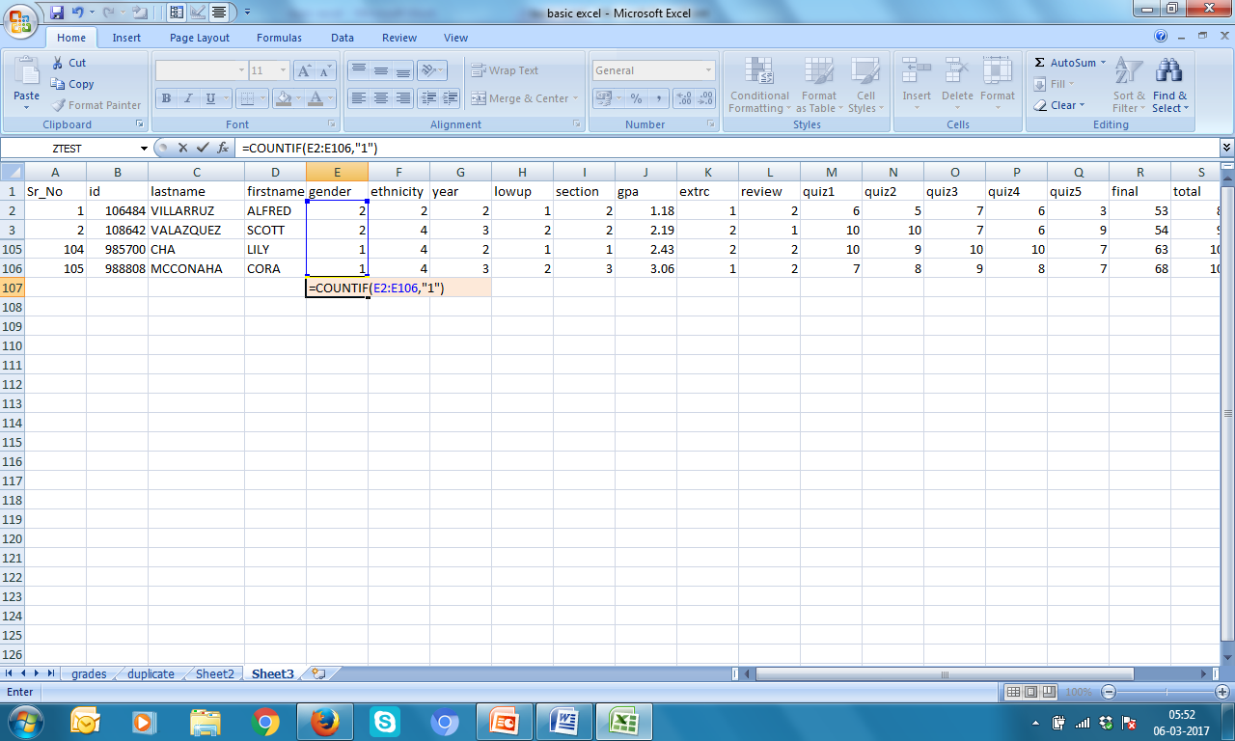
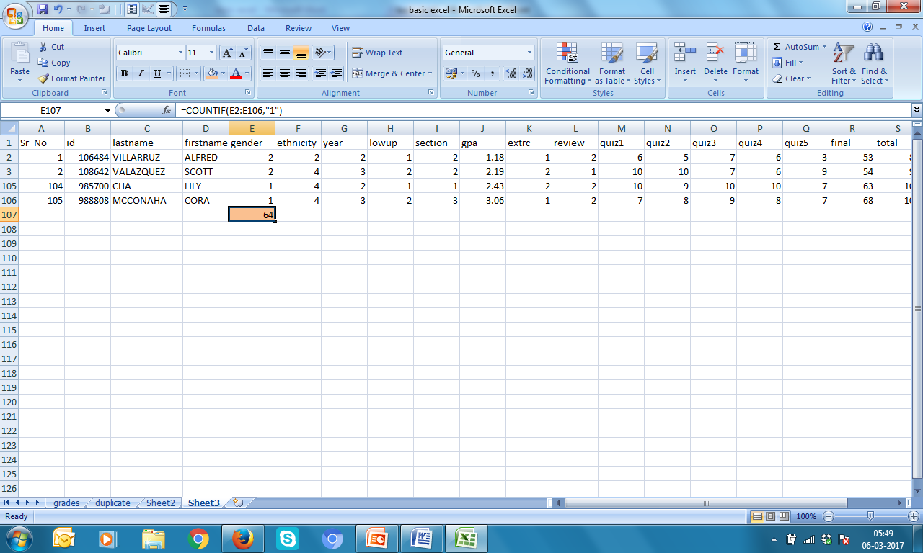
COUNTIF In cell E107, type =COUNTIF(E2:E106,”1”) → Enter

Slide 10
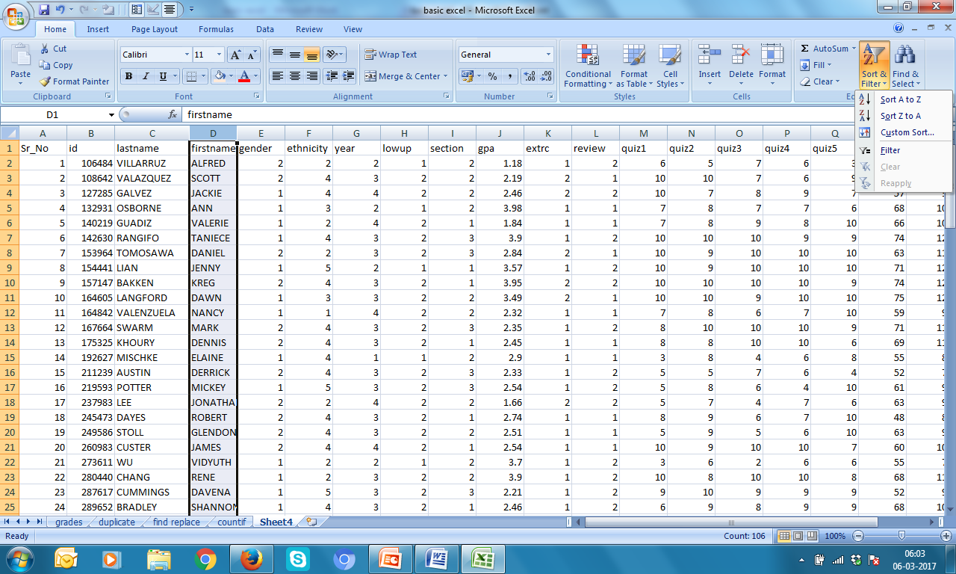
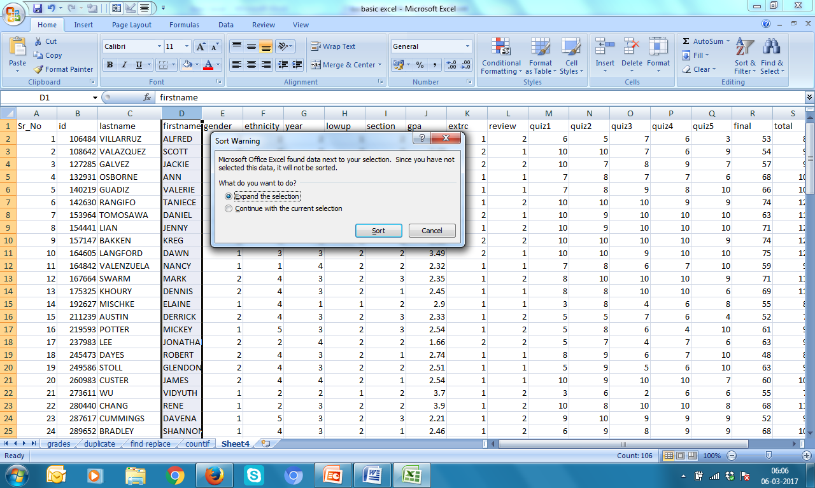
Ascending or Descending order
Select row → Sort & Filter → Sort A to Z
Expand the selection → Sort

Slide 11
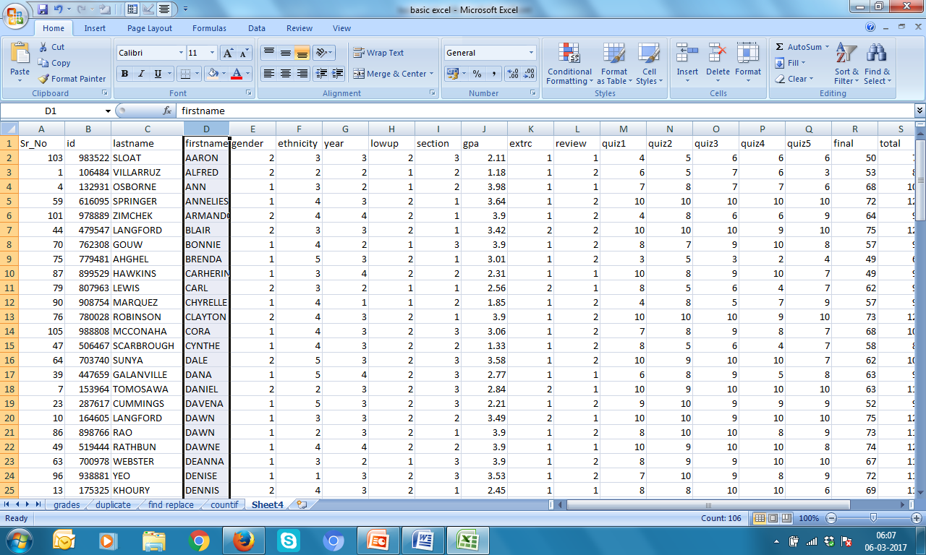
Ascending or Descending order
Sorted column

Slide 12
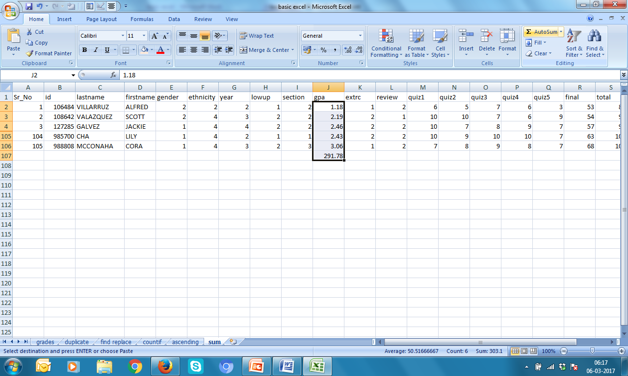
Find SUM
Hide some rows → Select range J2:J106 → click Autosum → You will have sum in cell J107

Slide 13
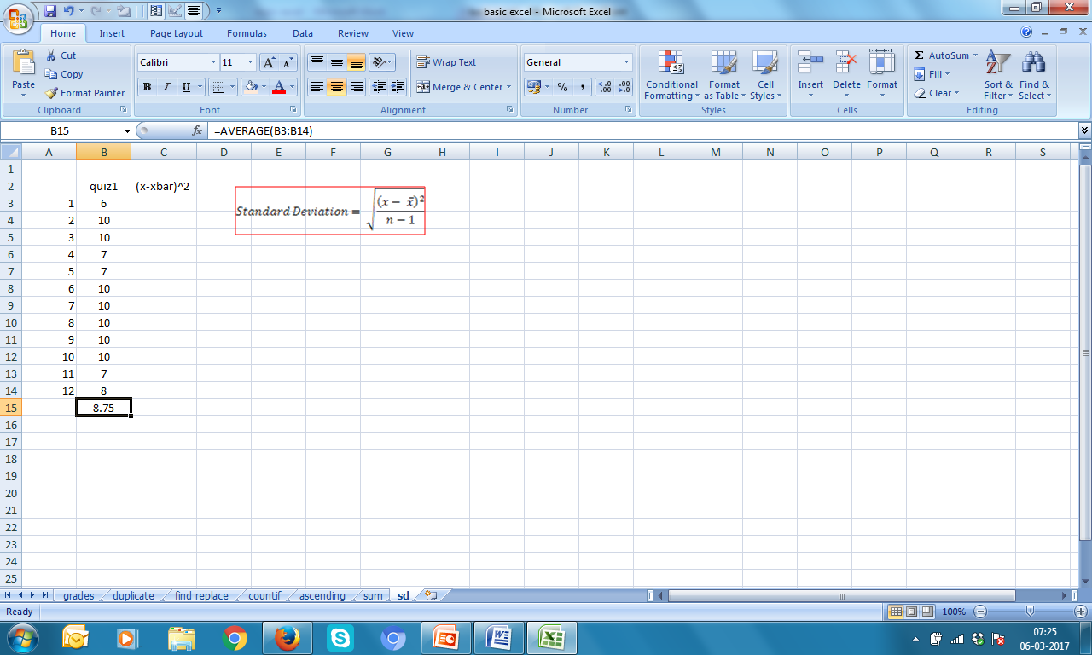
Calculate Standard Deviation
1. In cell B15 type =AVERAGE(B3:B14) then ENTER

Slide 14
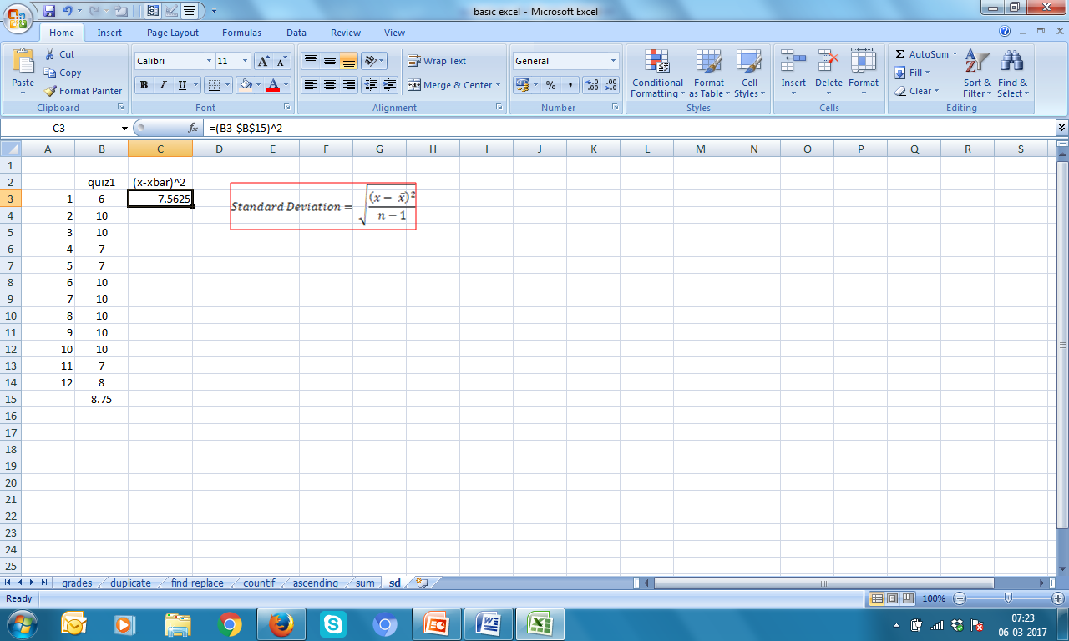
Calculate Standard Deviation
2. In cell C3 type =(B3-$B$15)^2 then ENTER

Slide 15
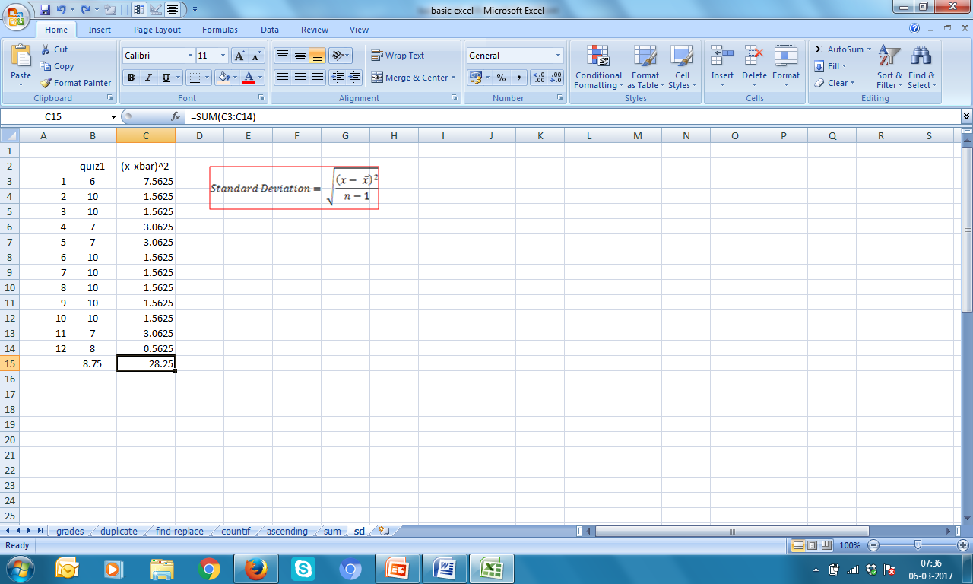
Calculate Standard Deviation
3. Hold the + sign at right bottom of cell C3
and drag till C14
4. Find SUM in cell C15

Slide 16
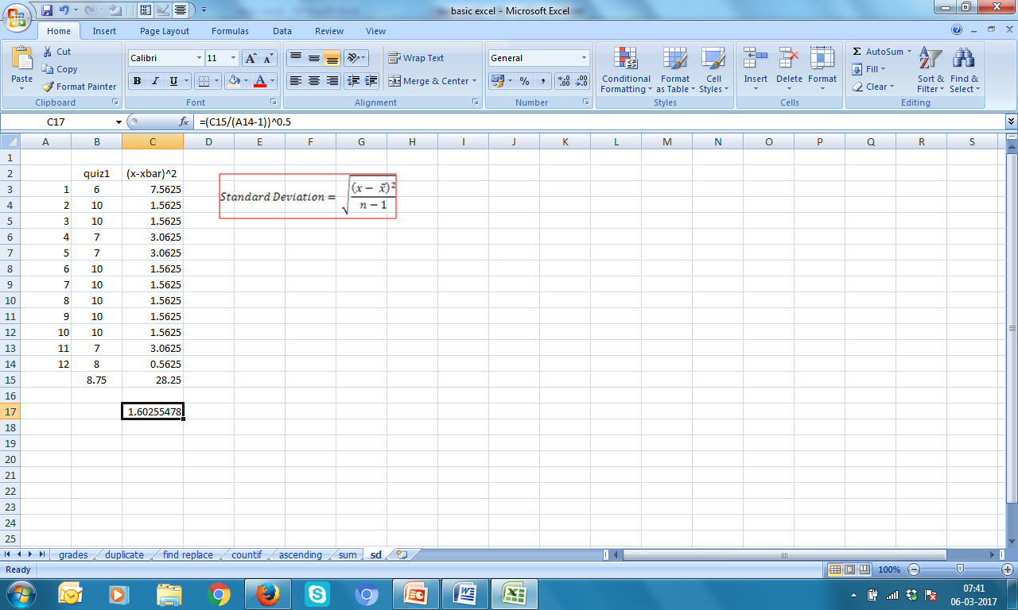
Calculate Standard Deviation
In Cell C17 type =(C15/(A14-1))^0.5
and ENTER

Slide 17
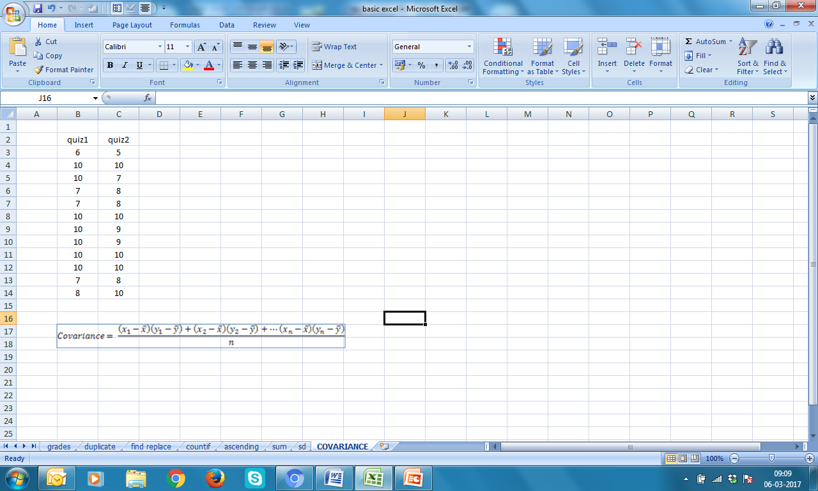
Exercise 1 Calculate Covariance

Slide 18
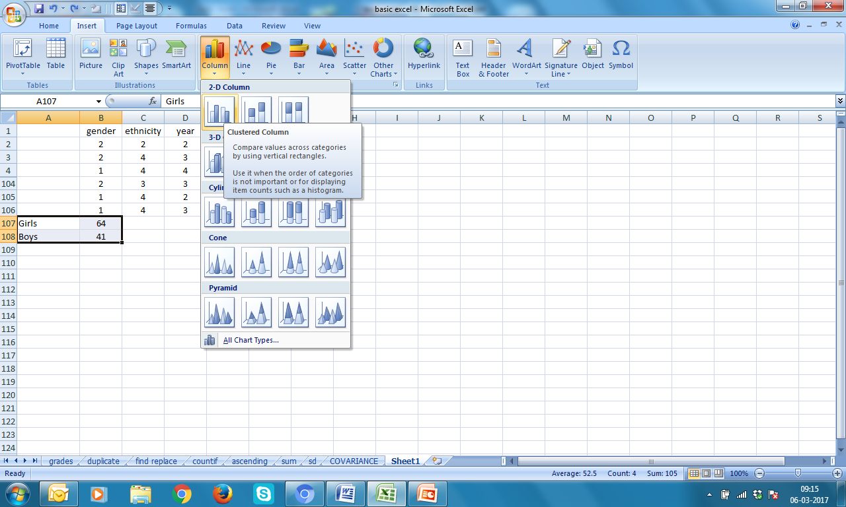
Bar Diagram of gender
Find COUNTS of 1 (girls) & 2(boys) → select A107:B108 → Insert → Column → select first one

Slide 19
Bar Diagram of gender

Slide 20
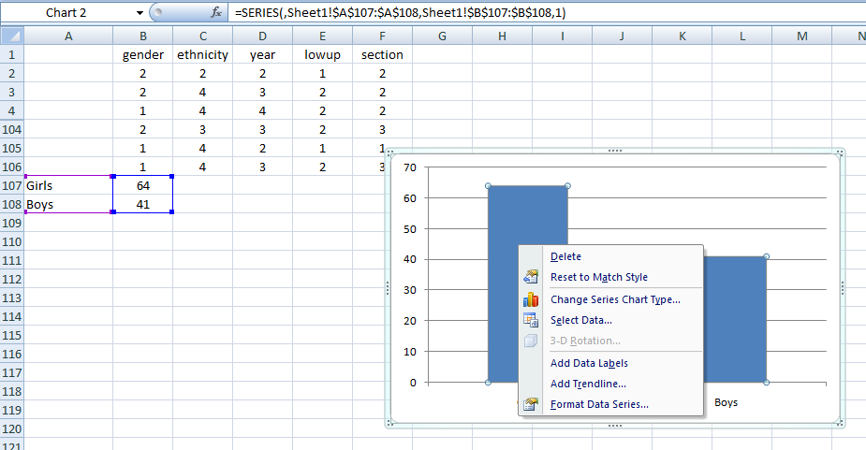
Add Data Labels
Remove series → select bars (one click on any bar) → Right click → Add Data Labels

Slide 21
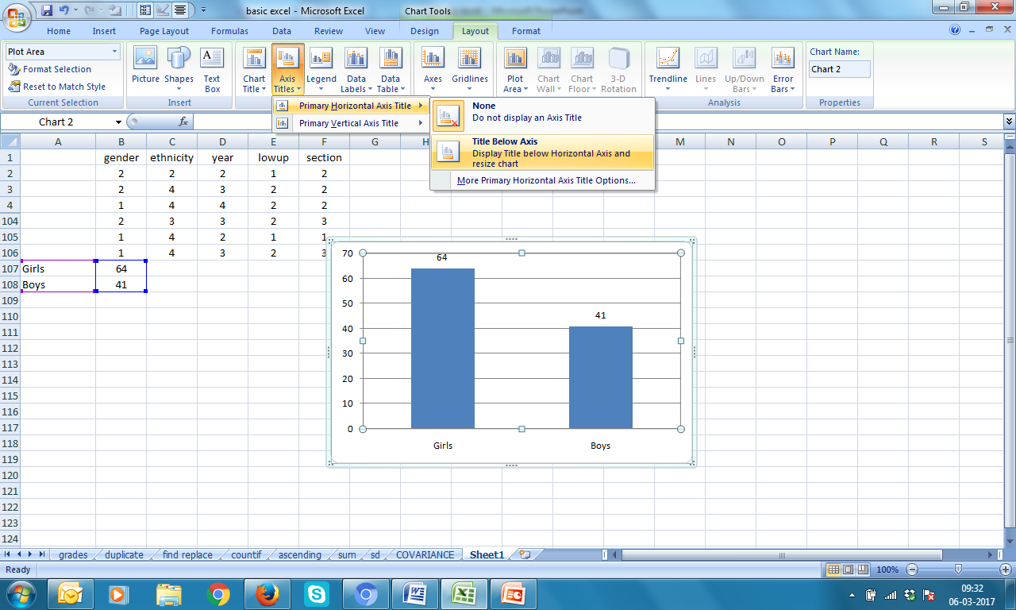
Name Horizontal Axis
1. Click on chart → Layout → Axis Titles → Primary Horizontal Axis Title → Title Below Axis

Slide 22
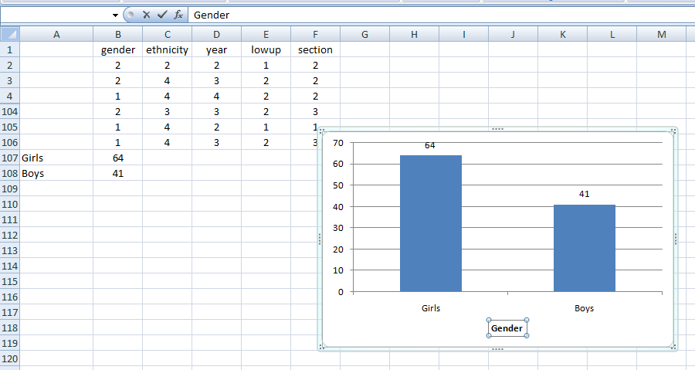
Name Horizontal Axis
2. Type Gender in function space

Slide 23
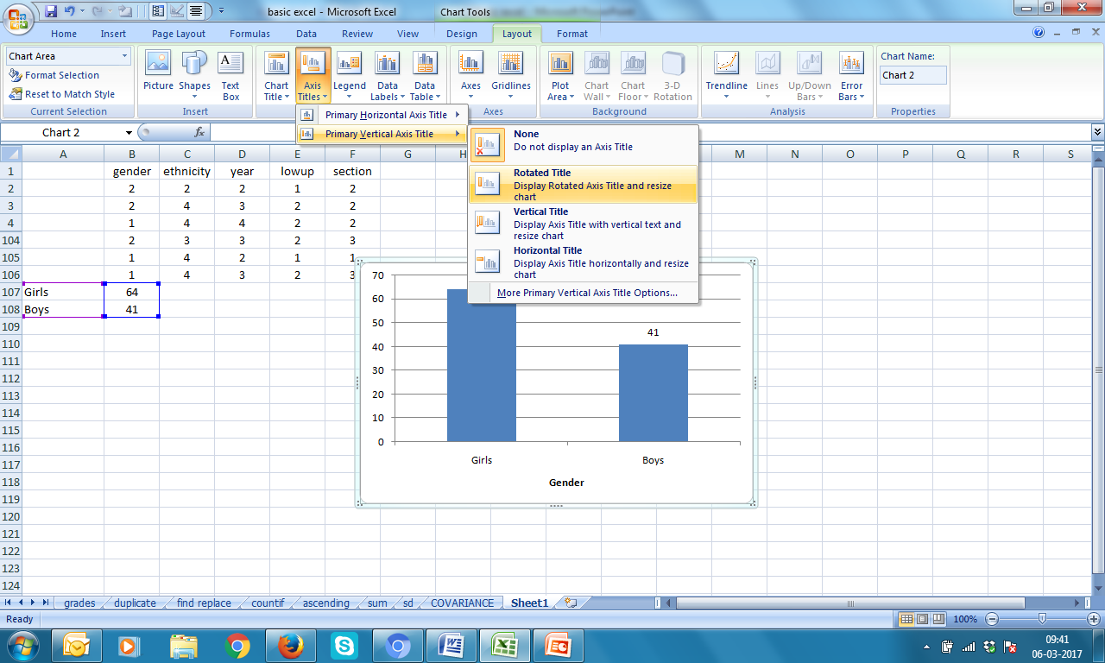
Name Vertical Axis
1. Click on chart → Layout → Axis Titles → Primary Vertical Axis Title → Rotated Title

Slide 24
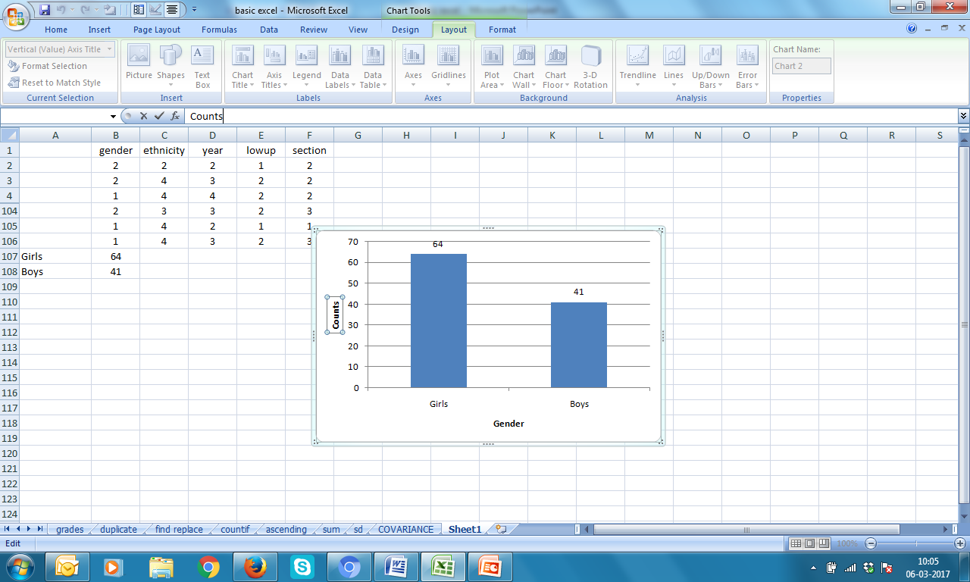
Name Vertical Axis
2. Type Counts in function space

Slide 25
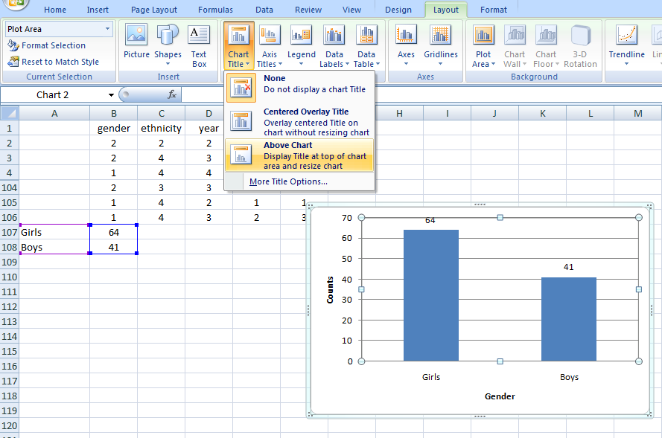
Name the Chart
1. Click on chart → Layout → Chart Title → Above Chart

Slide 26
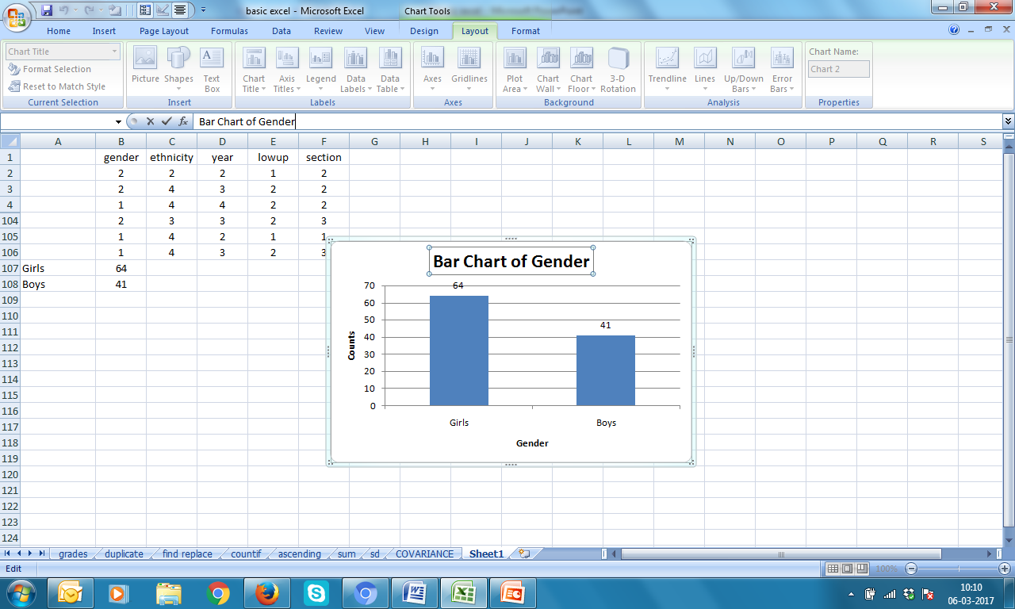
Name the Chart
2. Type Bar Chart of Gender in function space

Slide 27
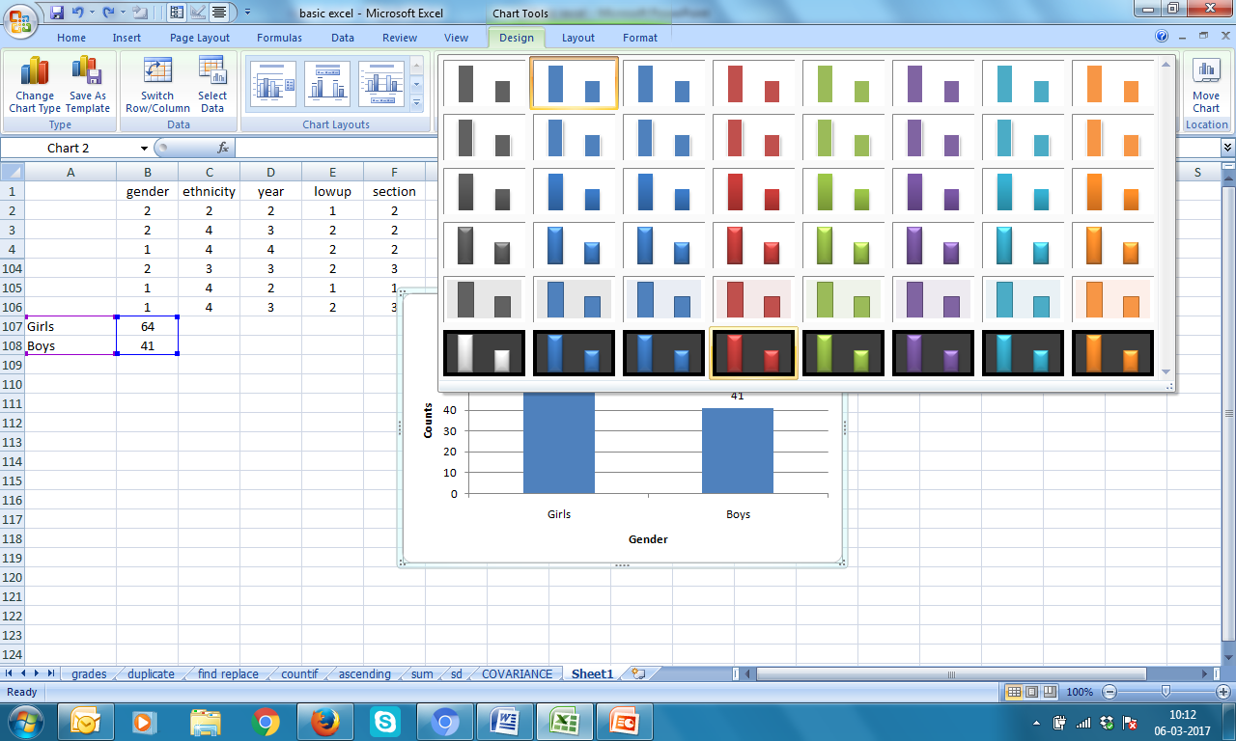
Lets choose better design
Click on chart → Design → select design of your choice

Slide 28
See the difference!

Slide 29
Exercise 2 Plot Bar Chart for ethnicity

Slide 30
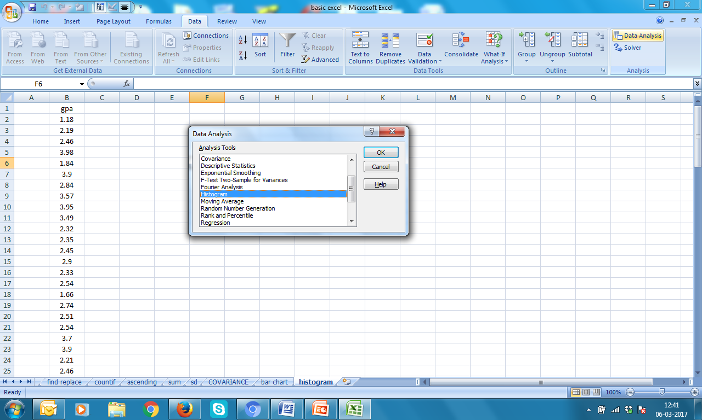
Histogram of gpa
1. Data → Data Analysis → Histogram → OK

Slide 31
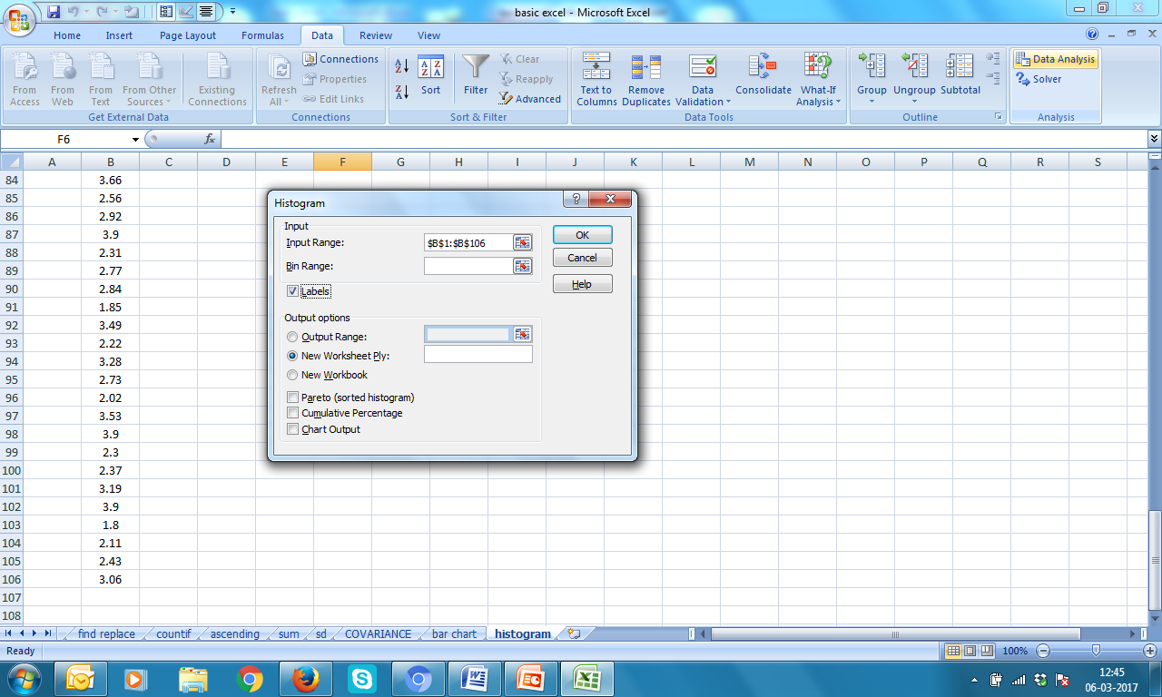
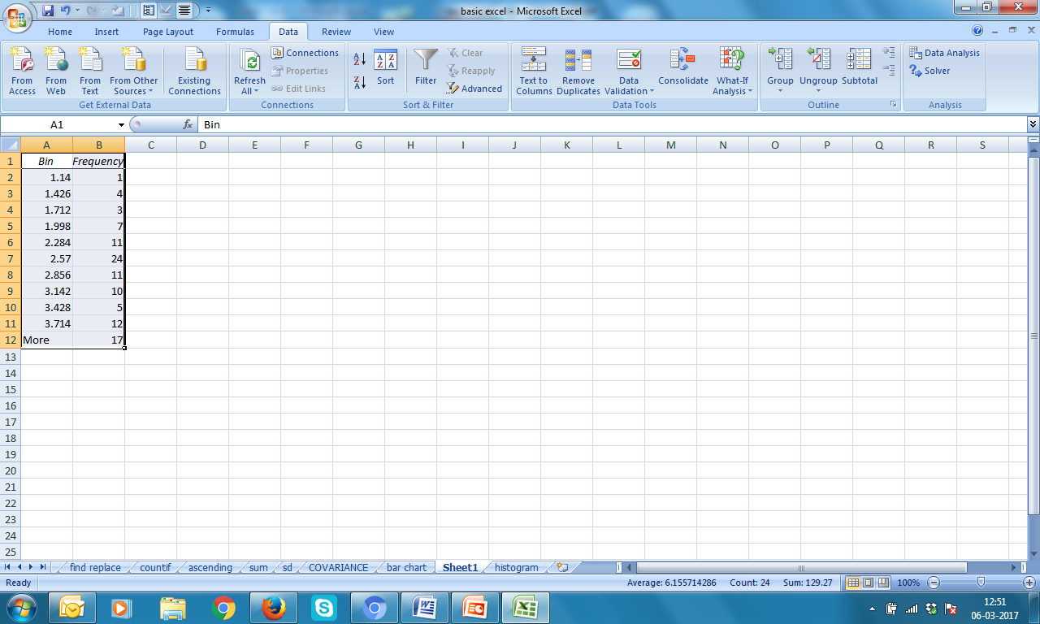
Histogram of gpa
2. Feed data range B1:B106 in Input Range
Check Labels and click New Worksheet Ply: → OK
output

Slide 32
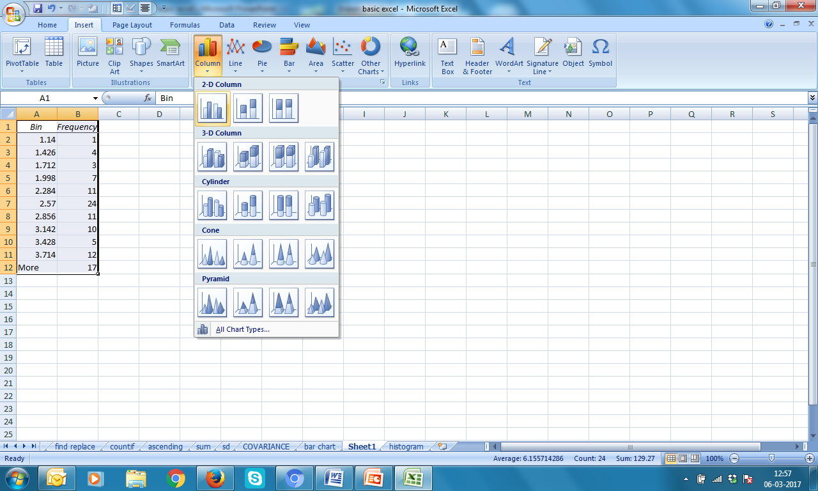
Histogram of gpa
3. Select A1:B12 → Insert → Column --> select the first one

Slide 33


Histogram of gpa Lets make it better

Slide 34
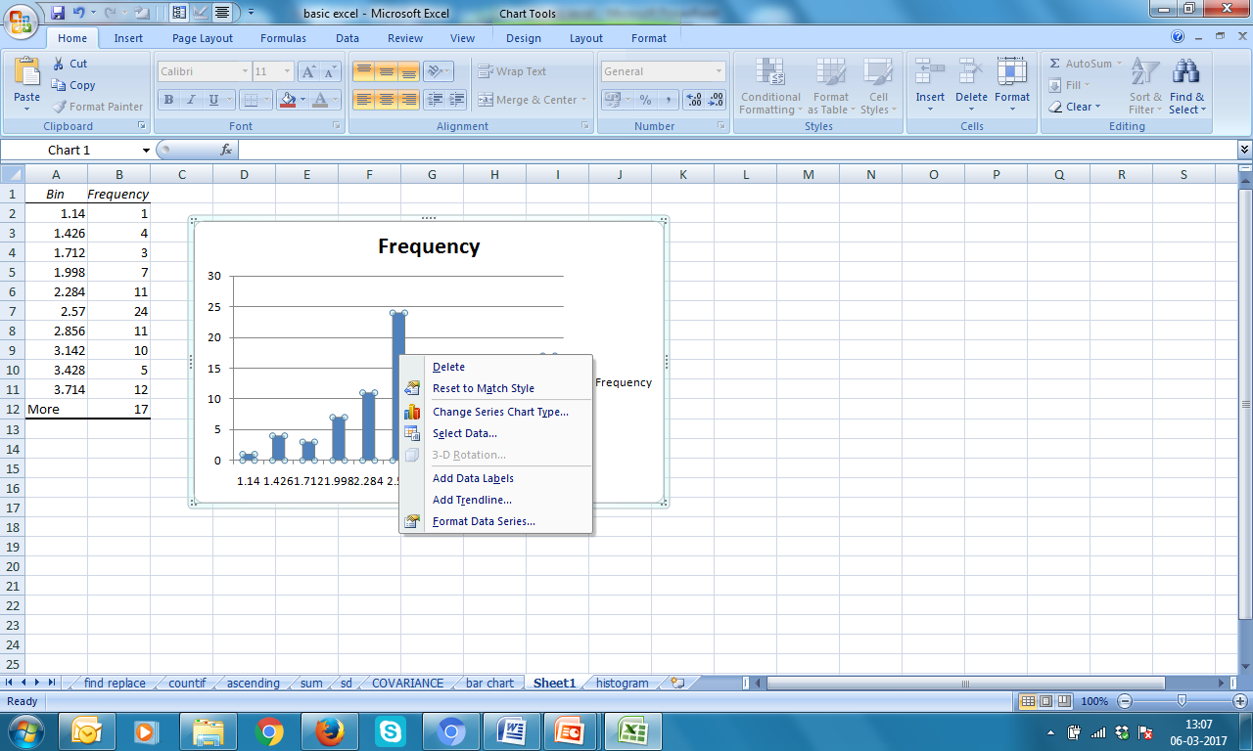
Make up!
4. Keep cursor on any bar → right click → Format Data Series

Slide 35
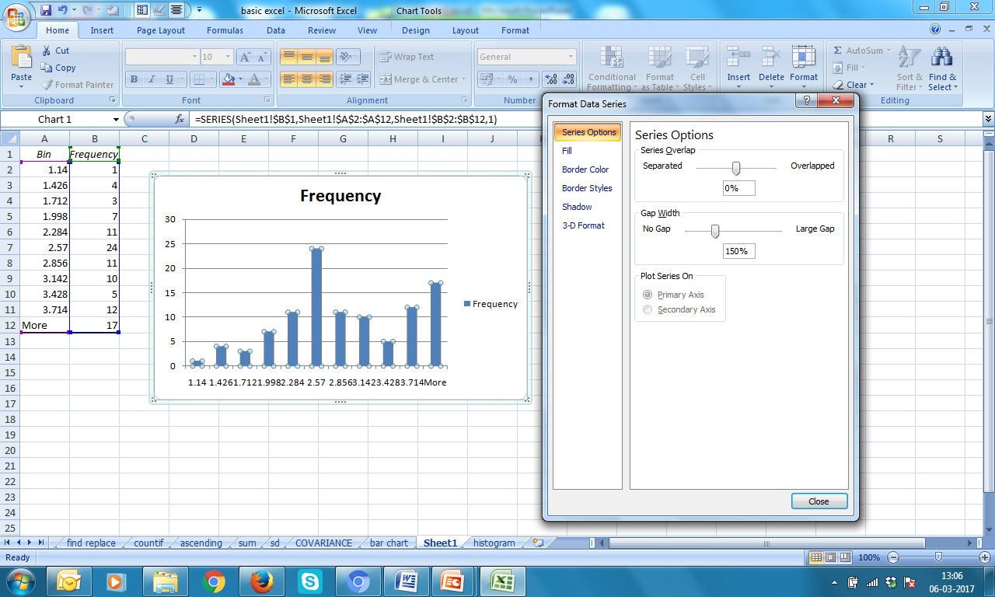
Make Gap Width as NO GAP
5. Bring the slider to left most place
Move this slider to left most place

Slide 36
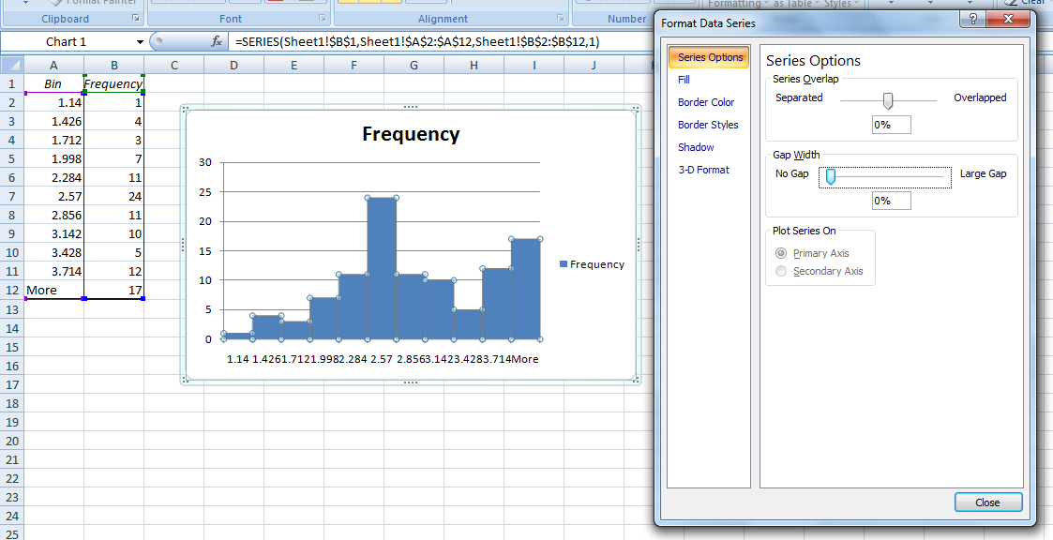
Wow!
6. Now use Layout for giving Titles to axes & Chart name
Design for making attractive (refer previous slides for Bar Chart)

Slide 37

How it looks like?

Slide 38
Exercise 3 Make histogram of quiz1

Slide 39



